Slide 1
D-310 Unit 7: Predictive Services

Slide 2
Objectives
Students will be able to:
Describe how the Predictive Services function is critical to priority setting and decision making.
Describe the role of the Expanded Dispatch Support Dispatcher (EDSD) as it relates to the Predictive Services function.
Identify the basic types of information that may be of interest to the Intelligence Coordinator and/or Information Officer.

Slide 3

Incident Position Standards Alignment
This unit aligns with the following EDSD Incident Position Standards located at
https://www.nwcg.gov/positions/expanded-dispatch-support-dispatcher/standards-and-references.
EDSD responsibility alignment
Gather critical information pertinent to the assignment.
Obtain situational awareness.
Establish and maintain communication with frequent contacts.

Slide 4
Intelligence
Incident intelligence describes the collection and analysis of wildland fire or incident-specific data used for strategic planning and decision-making.

Slide 5
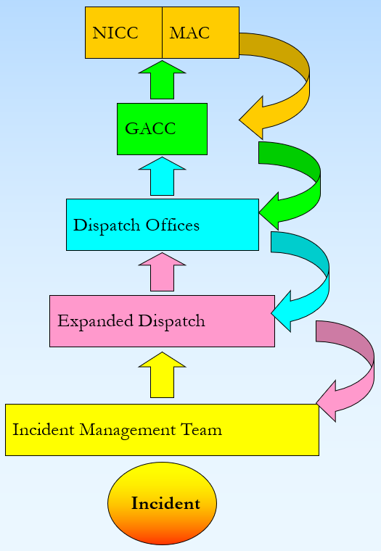
Intelligence Flow

Slide 6
Role of the EDSD
Collect and consolidate incident resource information.
Disseminate the information.

Slide 7
Collect and Consolidate Incident Information
HOW will you find the information?
Interagency Resource Ordering Capability (IROC) system reports
Incident Status Summary (ICS 209)
Local reports
WHAT information are you looking for?
Number of open or unfilled requests
Unable to fill (UTF) requests from the local and national levels
Resources available for reassignment or demobilization

Slide 8
Disseminate the Information
WHERE should you be disseminating the information?
Formal or informal briefings.
Reports, summaries, etc.
WHO will need this information?
Supervisory dispatcher
Information Officer
Duty Officers/local Multi-Agency Coordinating (MAC) Group
Geographic Area Coordination Center (GACC)/GACC MAC Group
National Interagency Coordination Center (NICC)/National MAC (NMAC) Group

Slide 9
Why Is Intelligence Critical?
Keeps managers and expanded dispatch informed to make decisions.
Indicates increased competition for resources at higher preparedness levels.
Aids priority setting.
Identifies critical resource shortages.
Provides pertinent information to all levels of the dispatch/coordination system.

Slide 10
Predictive Services Products
Incident Status Summary (ICS 209)
Incident Management Situation Report (IMSR)
Active wildland fire maps (e.g., Fire Enterprise Geospacial Portal [EGP])
Weekly/monthly/seasonal Fire Potential Outlooks
Other local examples

Slide 11
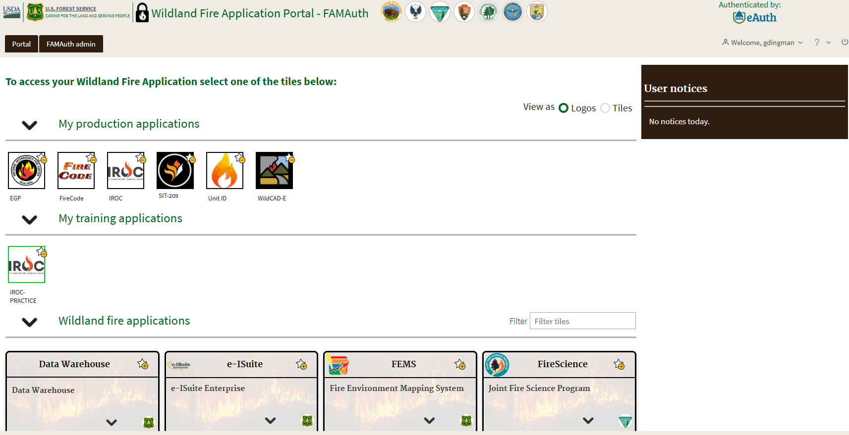
Wildland Fire Application Portal (FAMAuth)

Slide 12
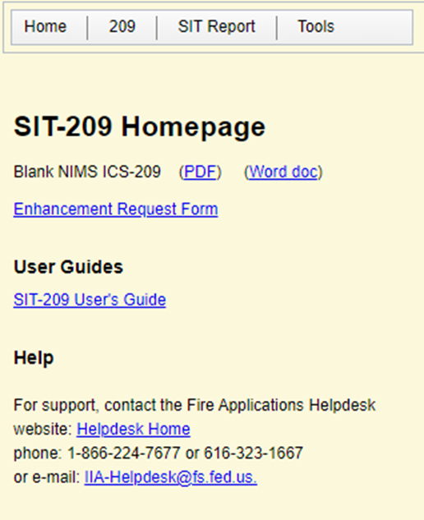
Sit / 209 Reporting

Slide 13
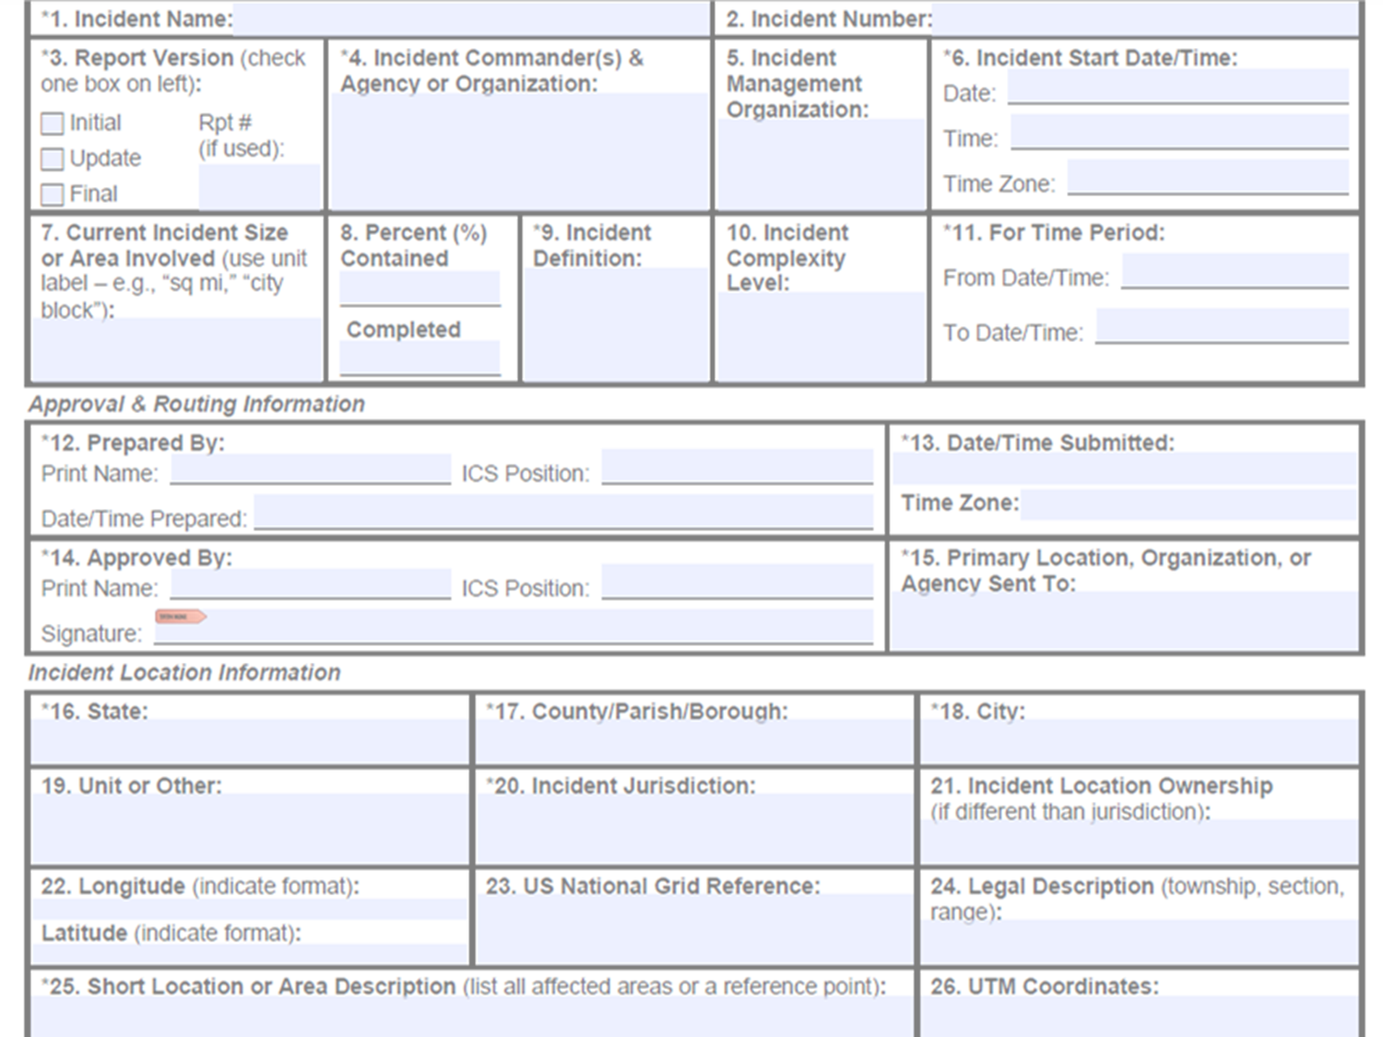
Incident Status Summary (ICS 209)

Slide 14
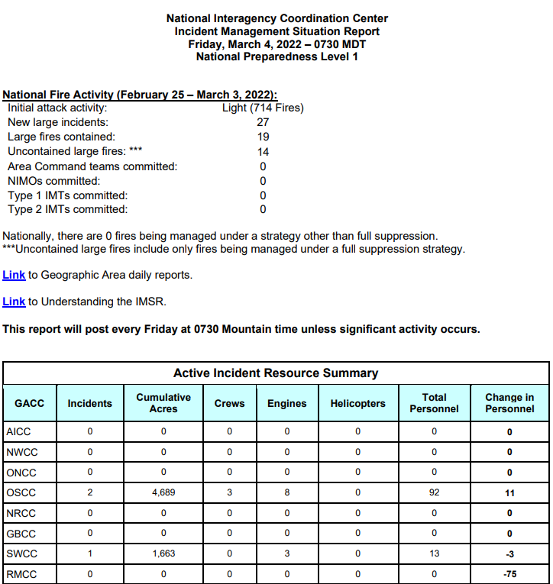
Incident Management Situation Report (IMSR)

Slide 15
Active Wildland Fire Maps

Slide 16
Fire Potential Outlooks
Each GACC’s Predictive Services Meteorologists produce nationally standardized and regionally specific fire potential products.
7- Day Fire Potential Outlook
Monthly/Seasonal Outlook
Web briefings
Other localized products

Slide 17
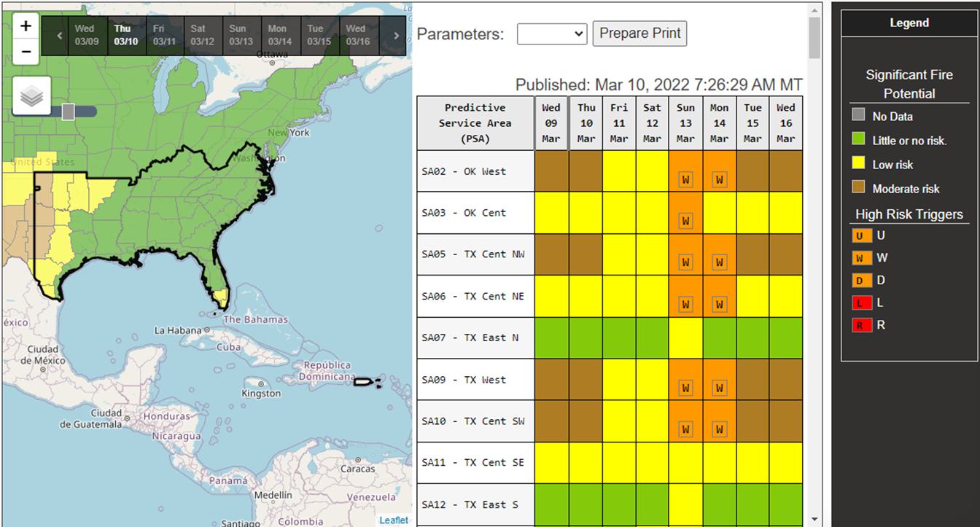
Fire Potential Outlooks: 7-Day Product

Slide 18
Summary
Formal intelligence flows through the incident support system channels.
The EDSD collects, consolidates, and disseminates incident resource information.
Information is found in IROC reports, Incident Status Summary (ICS 209), and local reports and is disseminated via briefings and reports.
Predictive Services is comprised of meteorologists, Intelligence Coordinators, and additional decision support.
Predictive Services produces a number of products, including Incident Status Summary (ICS 209), IMSR, active fire maps, and Fire Potential Outlooks.

